Slide 1
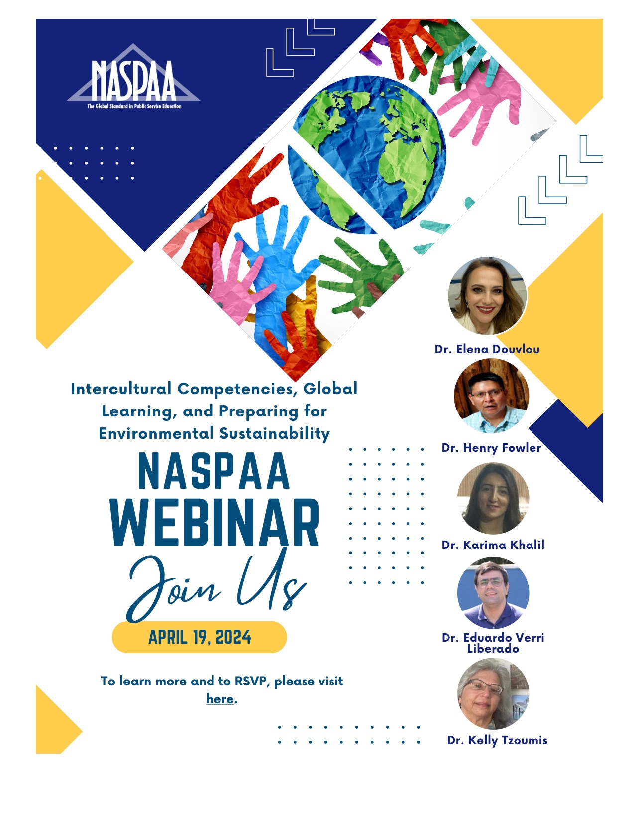

Slide 3
Intercultural and Global Learning – Achieving the UN SDGs Webinar
Prof. Elena Douvlou – Associate Professor, Associate Dean, School of Architecture, Faculty of Engineering & Architecture Metropolitan College, Greece (edouvlou@mitropolitiko.edu.gr)
Prof. Henry Fowler – Associate Professor, Mathematics/Dine Studies, Faculty, Navajo Technical University, Dine Studies, Navajo Technical University, Navajo Nation (hfowler@navajotech.edu)
Prof. Karima Khalil – Professor, Cadi Ayyad University, School of Technology of Essaouira, Morocco (ka.khalil@uca.ma)
Prof. Eduardo Verri Liberado, – Assistant Professor, Sao Paulo State University (UNESP), Institute of Science and Technology, Sorocaba, Brazil (verri.liberado@unesp.br)
Prof. Kelly Tzoumis – Professor, DePaul University, School of Public Service, Chicago, IL USA (KTzoumis@DePaul.edu)

Slide 4
agenda
Introduction
Student Meetings
Tools
Discussion, Questions and Answers
Introduction
Why Global Learning?
Preparing the Learner at home for Global Citizenship
The Importance of Intercultural Training:
Before the Interaction
Two Student Meetings
1. The Ice Breaker
2. The Second Meeting-The New Ecological Paradigm (NEP)
Engaging Tools for Global Learning
Role-Playing Games and Simulations
AR/VR (360-3d) with Project-Based Learning
Conclusions and Questions/Answers

Slide 5
Why is Global Learning Experiences necessary in post-secondary education?
What are some of the best practices for global learning?

Slide 6
Why Global Learning Experiences for our Students?
1. Preparing learners for the “global imperative” of the workplace and professional praxis.
2. Global interactions must occur in the courses before praxis.
3. Building intercultural skills sets and competencies.
4. Diversity and accessible interactions are enhanced in global learning.

Slide 7
Why Global Learning Experiences for our Students?
Global Learning Options
Take courses on international and comparative studies of countries.
Study abroad Trips.
Internships, exchanges abroad, ERASMUS+.
Fulbright, Boren, and other immersion experiences.
Virtual Exchanges (VE) or known as Collaborative Online International Learning (COIL) or Global Learning Experience (GLE).

Slide 8
Some Definitions (VE, COIL, GLE)
VE- Virtual Exchange use of technology to bring students together while remaining at their home institutions.
COIL –Collaborative Online International Learning
-SUNY faculty innovators who were each exploring ways to bring international students into their classrooms using technology.
GLE - Global Learning Experience – Bringing students together for meaningful global collaborations inside of courses using a variety of tools. Importance of building relationships between the global faculty members for continued delivery of courses and experiences for the learner.

Slide 9
Global Learning using Virtual Exchanges
connects students and professors in different countries for collaborative projects and discussions as part of their coursework.
provide meaningful, significant opportunities for global experiences built into programs of study.
enhances intercultural interaction through proven approaches to meaningful online and virtual engagement, while providing universities with a cost-effective way to ensure that their students are globally engaged.
empowering professors, students, programs and institutions to embrace diversity through inclusive teaching and learning focused on equity and diversity in culture, race and ethnicity, gender identification, socioeconomics and accessibility.
Learning Outcome
-to collaborate for solving problems using intercultural competencies designed for praxis as a Global Citizen.

Slide 10
Post-Secondary Education Requires Interactions at the Global Level of Our Students…
GLE is a DEI game changer…
Resilient pedagogy to pandemic, inclement weather, transportation issues, illness, childcare issues, work and internship conflicts …

Slide 11
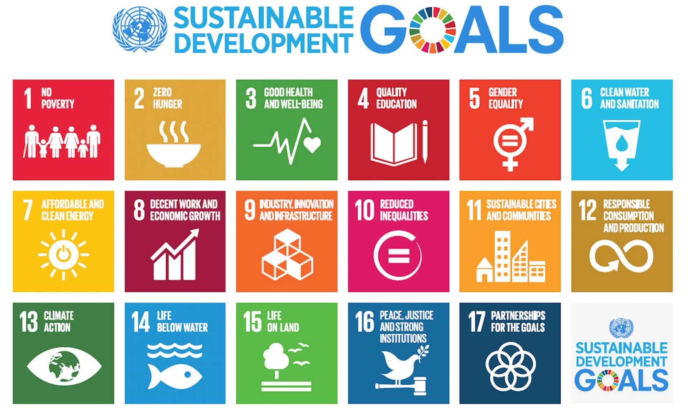
Example--Achieving the UN Sustainability Development Goals (SDGs)
Goal 4 focusses inclusive and equitable quality education and promotion of life-long learning opportunities for all focuses on eliminating gender disparities in education and ensuring equal access to all levels of education for the vulnerable, including persons with disabilities.
In addition, the goal calls for building and upgrading education facilities that are disability and gender sensitive and provide safe, non-violent, inclusive and effective learning environments for all.

Slide 12
Why is Global Learning Experiences necessary in post-secondary education?
What are some of the best practices for global learning?

Slide 13
Best Practices For Global Learning
Faculty Partnering
Subject Matter Discipline
Reflection
Empathy
Faculty Partnering
Empathy Building Phase
Central Subject Matter Content Phase
Reflection Phase and Processing Phase
How to get a partner?
Intercultural training and self-awareness
Two student meetings
Assignment that can involve a global team effort.
Opportunity for learner to reflect and process what was taught both content and intercultural learning and build metacognition.

Slide 14
How to Connect to a Faculty Partner for a Global Learning Experience?
Identify Goals
Create a partnership that is sustainable over time.
Can lead to global research in your field.
Provide for an enriched learning experience that is seamless for all students.
Advance professional and personal contacts worldwide.
Provide access to learner that do not have the ability to engage with other global leaners or professors.
Faculty Partnering
What are your goals for this interaction?
What are your partner’s goals?
https://www.youtube.com/watch?v=X3xVcdTMpcs

Slide 15
How to Connect to Faculty Partners for a Global Learning Experience?
Ideas on Source | Technique | Investment and Outcome Considerations
Existing Contacts | Reach out to previous contacts. Get referrals from existing partners. | Easiest to create and high likelihood of success.
Conference Networking (IVEC, discipline, AACU, etc.) | Use network rooms, embassy, social media postings, consulates. | Takes multiple steps with follow-through.
Targeted Research | Email introduction and request for collaboration. | Takes just 1-2 steps with connecting to a new partner. Pre-selection bias (response) helps finding partner. The virtual email “door knock.”
University Referral | Easiest to make a connection. | Can be effective. Requires time to build relationship.

Slide 16
GLE Team (9 countries, 5 continents, 11 partners)
Brazil – University Referral
Greece – Targeted Research and visit during conference.
Lesvos – Targeted Research
Japan – Referral from Partner (inactive)
France – IVEC Conference 2021 (plus Embassy)
Italy – (First Partner)- Existing Contact from Fulbright
Italy – Referral from Partner
Morocco – IVEC Conference 2022 (newest partner)
Navajo Nation – Targeted Research – email
Netherlands – Research Conference (Discipline)
Spain – Research Conference (Discipline)

Slide 17
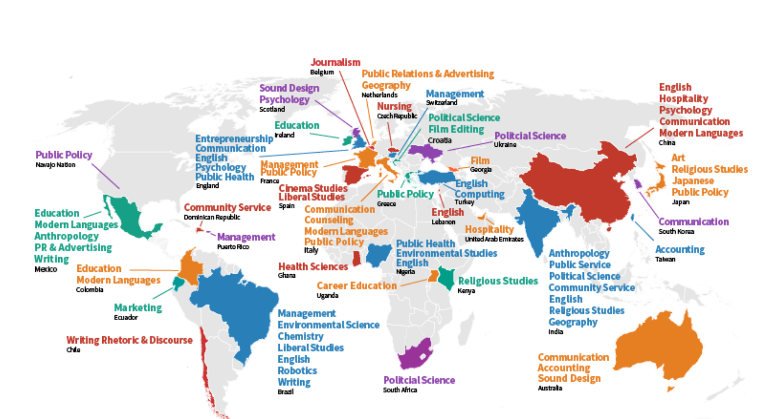
Depaul Global Learning Experience (GLE)
Intercultural Self-Awareness Assessment
Icebreaker (Student Meeting 1)
Environmental Worldviews (Student Meeting 2)
Assignment-Tools for Engagement
**Training faculty is critical.
**Building and maintaining faculty partners is fundamental.

Slide 18
Preparing Global Learners at Home
Readings
1. Intercultural Self-Awareness Assessments
2. Icebreaker Meeting 1
3. New Ecological Paradigm (NEP) Meeting 2
4. Engaging Assignment with Global Peers
5. Analysis
6. Reflection
Scaffolding
Critical Analysis and Reflection

Slide 19
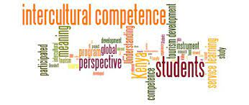
Intercultural competence
Empathy
Intercultural Competence
Being more effective in intercultural interactions through a better-informed frame of reference and appropriately adapted communication management styles
Have empathy, patience, and seek to understanding while engaging with others.
Intercultural Adaptability
Linking theory & new skills to own practice
Adapt your own behavior in culturally appropriate way
Intercultural Skills
Develop own intercultural behaviors, from communication to management styles
Develop intercultural competency and required skills

Slide 20
Intercultural Training and Self-Awareness Before the global exchange
Your Cultural Profile https://hbr.org/2014/08/whats-your-cultural-profile
Hofstede Insights Country Comparisons https://www.hofstede-insights.com/country-comparison/the-usa/
The Cultural Iceberg
https://iddresources.org/gle/introtoic/cultural-iceberg.html
Intercultural Competence
https://iddresources.org/gle/introtoic/index.html
Empathy

Slide 21
Roadmap
Cultural Taxonomies and Dimensions
Individualism/Collectivism
High/Low Context
High/Low Power Distance
Time Orientation
Task/Relationship Orientation
Uncertainty Avoidance
Evaluating
Persuading
Leading
Deciding
Trusting
Scheduling
Power
Intercultural Training and Self-Awareness
Student Meeting 1
Ice Breaker
Student Meeting 2
New Ecological Paradigm (NEP)
Environmental Worldviews

Slide 22
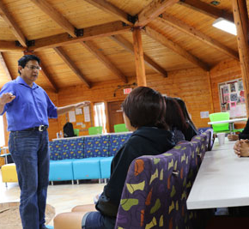
Global Learning about Sustainability and the Role of Environmental Worldviews
Dr. Henry Fowler, Navajo Technical University, Navajo Technical University, US

Slide 23
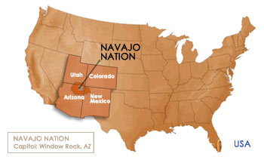
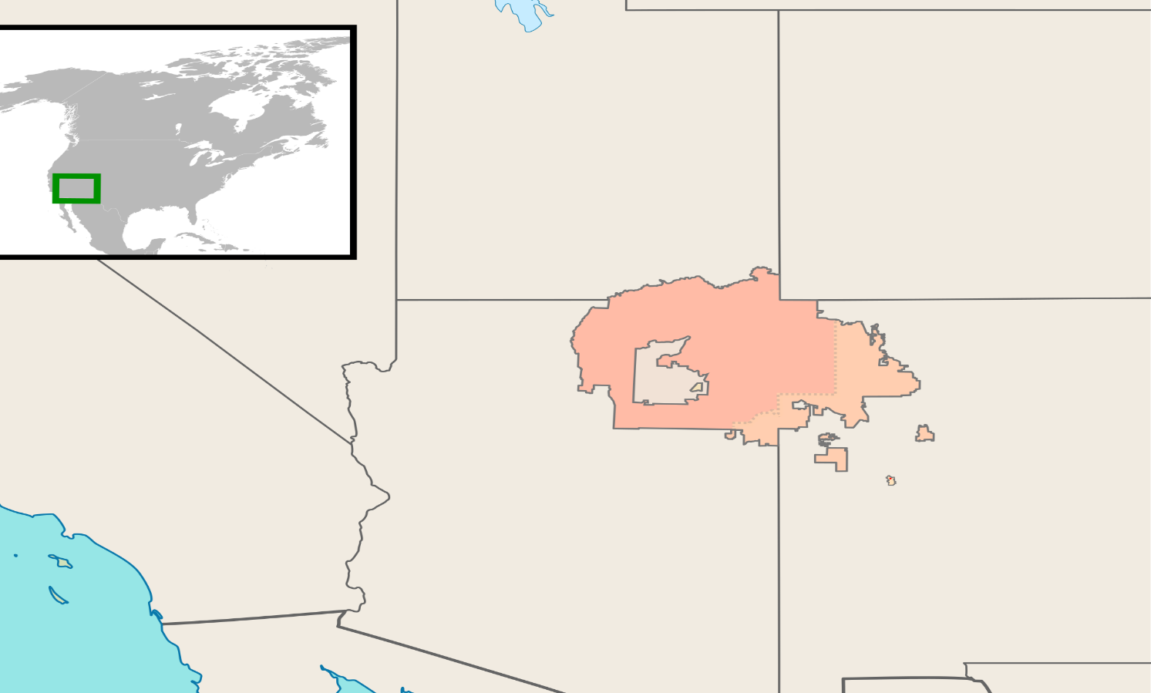
Importance of Environmental Worldviews as a Tool for Global Learning
Navajo Nation has 17,544,500 acres, occupying portions of northeastern Arizona, southeastern Utah, and northwestern New Mexico in the United States.
The Diné people are commonly called the Navajo Nation.
Notes:
Henry slide

Slide 24
Notes:
Henry slide

Slide 25
Environmental Worldviews
Using the New Ecological Paradigm (NEP)
survey begins a dialogue for understanding
environmental worldviews among the students.
Dunlap and Van Liere (1978); Revised in 2002.
IRB Approved Project (DePaul KT121318LAS, 2019)
Notes:
Henry’s slide
Discusses how students take the New Ecological Paradigm (NEP) as a tool to begin understanding the different cultures impact the student’s environmental worldview.
Consider this content below when preparing your live in-person presentation.
“To educate our students to become better prepared for the future and knowledgeable global participants, they begin by learning to understand each other. This is not done through just reading about each other, but also by interacting with each other.
Each student in the course first meets with 1 other student as an icebreaker encounter. Sometimes there will be only 1 other country in the course, and other times multiple countries. These are small groups where each country is represented by a student.
These students meet on Zoom to discuss issues of interest to them like politics, school, family, the pandemic, hobbies, or other topics of their choosing. No faculty are involved. This lasts for 30-45 minutes depending on the students and what is happening in the world.
Then, before the second meeting, the students all take a survey of 15 questions called the New Ecological Paradigm, or NEP, as it is commonly called.”

Slide 26
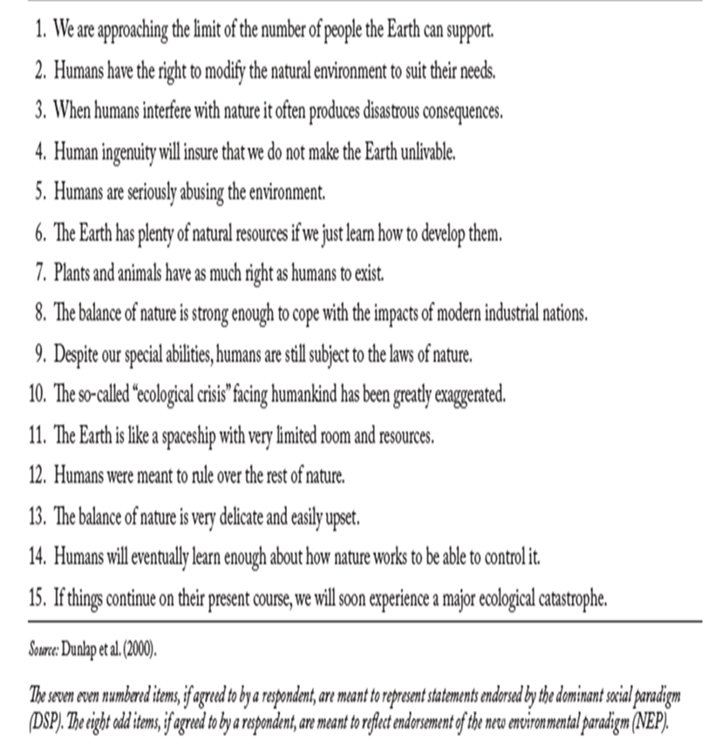
New Ecological Paradigm (NEP)
Dunlap and Van Liere (1977,1978, 2000, 2008)

Slide 27
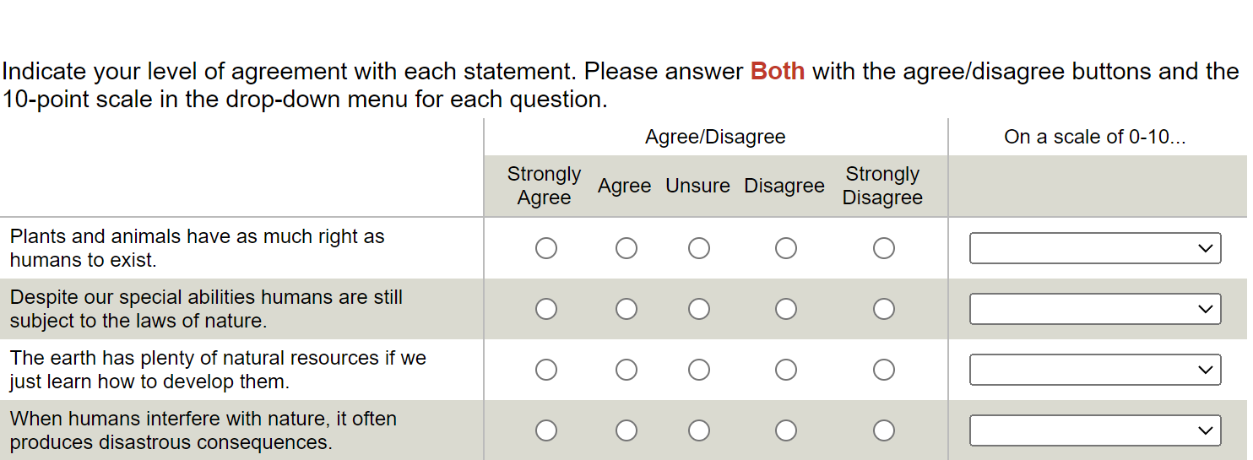

Slide 28
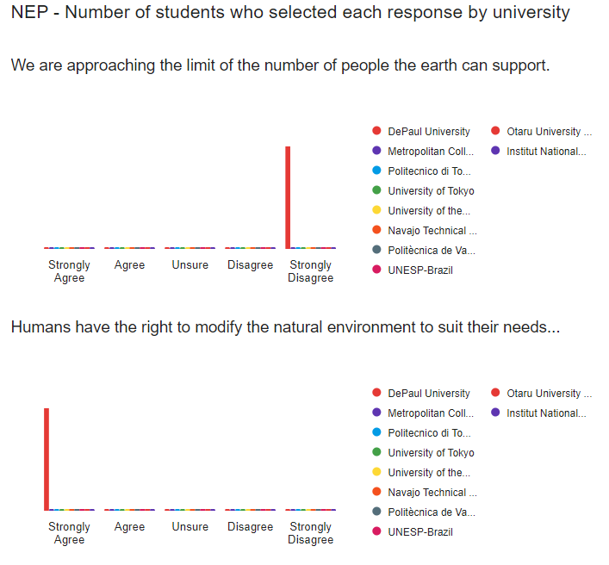
Results on Worldviews for Student Meeting 2

Slide 29
Learning About Each Other
Notes:
This is just example of a graph not real data.

Slide 30
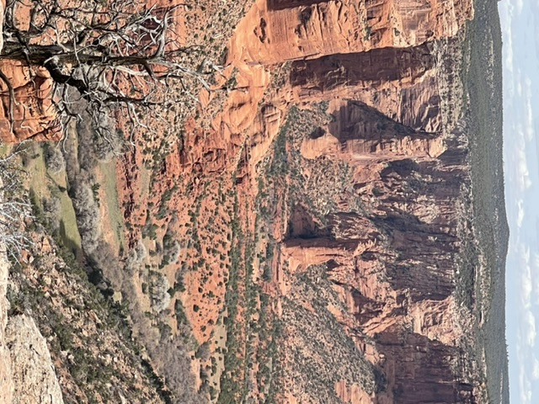
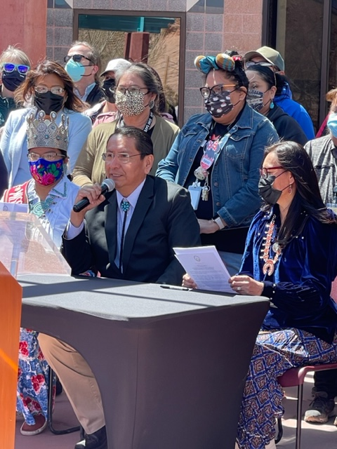
Importance of Environmental Worldviews as a Tool for Global Learning
What we have learned over time--solving global environmental issues requires integration of the cultural understanding of environmental worldviews of the people impacted.
Notes:
Henry slide
“What humans have learned over time is that we are connected. Therefore, solving problems, particularly environmental issues or achieving sustainability, requires the understanding of each other. For natural resource issues, the cultural priorities and understandings of environmental worldviews especially of the people impacted are critical for cooperation and decision-making.
All too often, we can’t get to solutions or protection of resources because we do not understand each other. We have sometimes not encountered each other until we enter the workforce and then are required to make decisions that we are not equipped for.
With global learning through virtual exchanges, our students can begin their global interactions with people not like themselves in their courses, before they have the responsibility to interact in the workplace.”

Slide 31
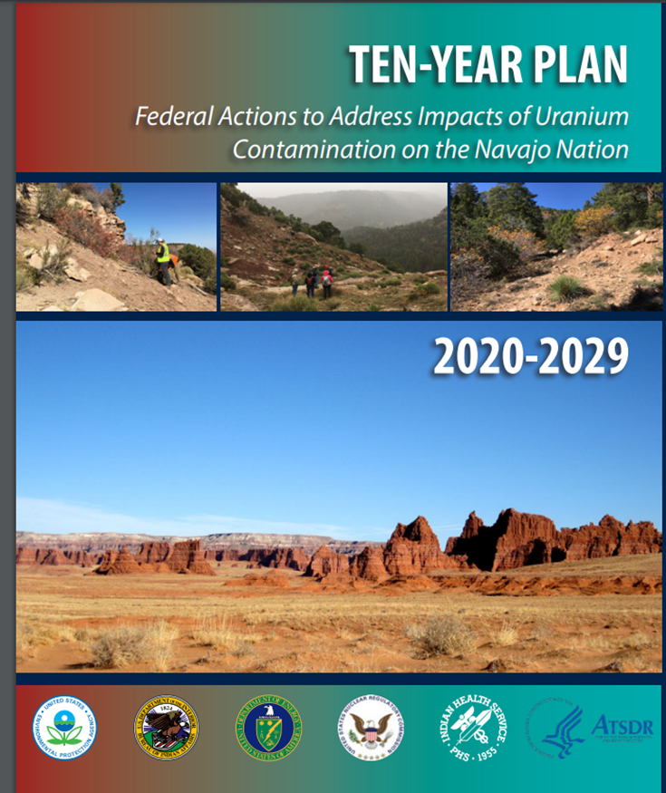
Importance of Environmental Worldviews as a Tool for Global Learning
Notes:
Henry slide
“Our students discuss an important environmental legacy that remains today in my country--the abandoned uranium mines that are being remediated. There were once over 900 mines abandoned from the mining of uranium. Today, EPA leads several US government agencies in the remediation of over 500 mines. This slide on the right shows the map of the abandon mines that have caused human health and environmental impacts to the Navajos.”
Add more here Henry. These are just suggestions.

Slide 32
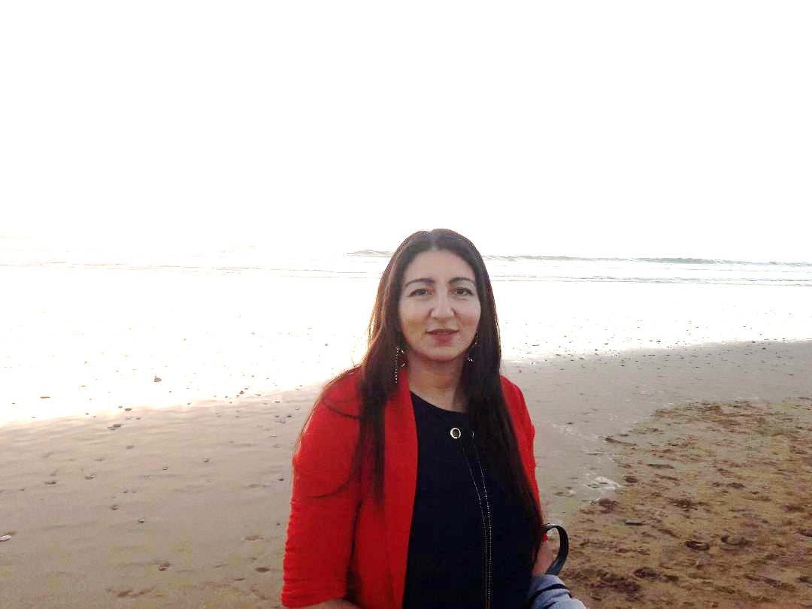
Global Learning about Sustainability and the Role of Environmental Worldviews
Dr. Henry Fowler, Navajo Technical University, Navajo Technical University, US
Dr. Karima Khalil, Cadi Ayyad University, School of Technology of Essaouira, Morocco
Dr. Kelly Tzoumis, Professor, School of Public Service, DePaul University, US
Aamna Fasihi, DePaul University, School of Public Service, US
Danielle Nickaf, DePaul University, School of Public Service, US

Slide 33
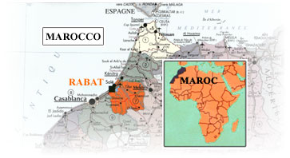
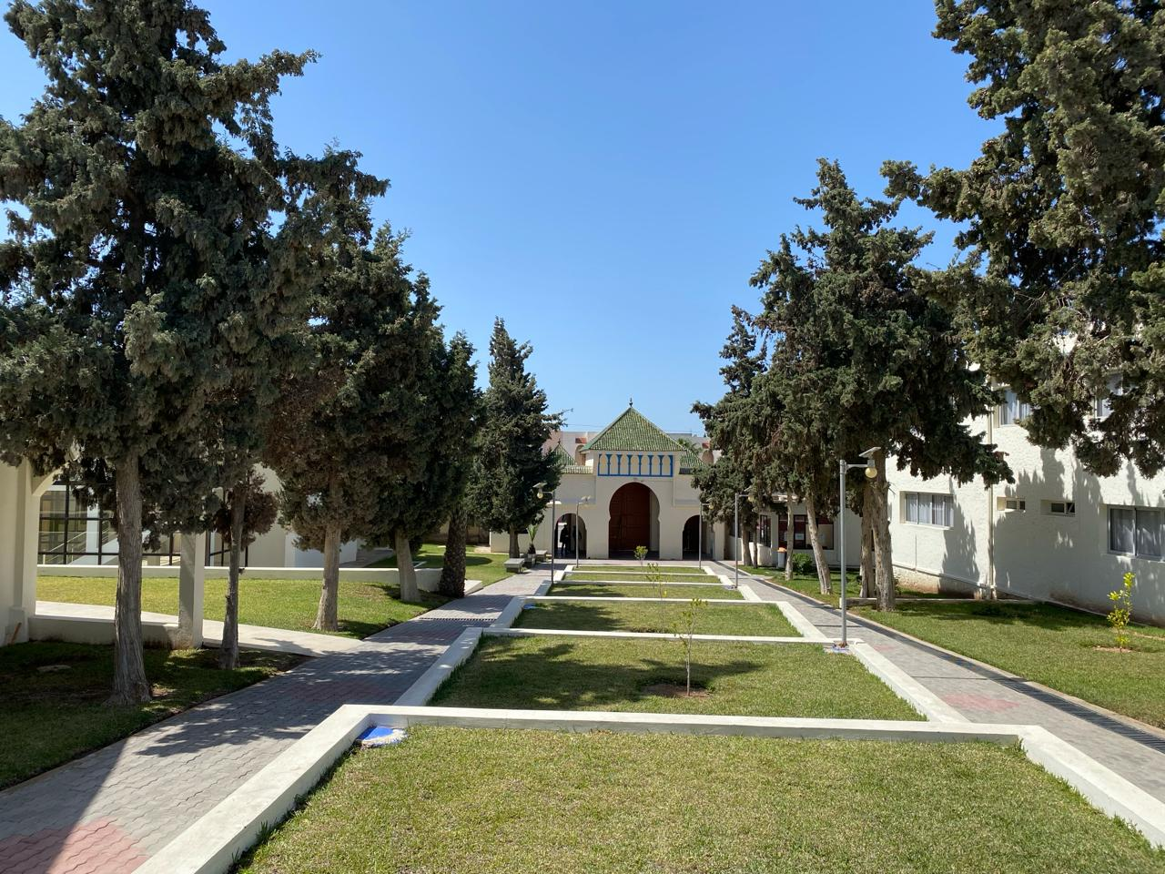
Dr. Karima Khalil, Professor at Cadi Ayyad University, School of Technology of Essaouira, Morocco
Prof. Khalil has lived many years abroad in France for her studies (Master and PhD) and for work (in academic and research institutions).
Research interests are: - Modeling of biogeochemical processes in coastal and marine environments - Marine Protected Area and fisheries - Marine Spatial Planning - Continent Ocean transfer and climate change impact.
She is coordinator and teacher in an international virtual exchange as member of Global Partner in Education with several partners from USA, Japan, China, Netherlands, France, Poland and others.
She is Secretary of African chapter of International Society of Ecological Modelling, Thematic Expert Group member of Global Marine Spatial Planning (UNESCO-IOC), editorial group member in Encyclopedia of Ecology with Elsevier.
.
Essaouira

Slide 34
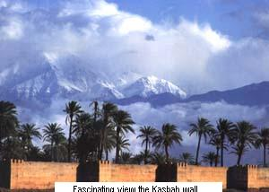
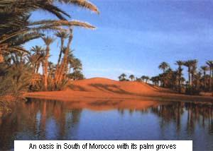
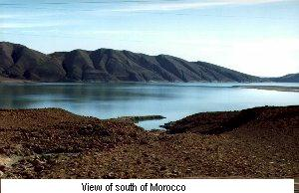
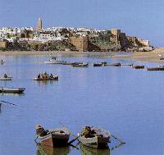
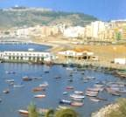
Environmental Worldviews in Morocco
Morocco, being a hybrid society which includes cultural, linguistic and ethnic diversity
The views on environmental change and the relationship of humans with regard to their natural environment are shaped by local beliefs, traditions, religious ideas, and economic activities
The learning method of environmental change is important to incorporate in research and policy; for instance, in sensitization about climate change within Morocco

Slide 35
Understanding Environmental Worldviews (EW)
Interested in the intersection of EW and Intercultural Dimensions on environmental sustainability.
Conducted the New Ecological Paradigm survey with a sample of n=889 from 2020-2023 with 35% Global South.
Use Cohen’s d (compares means) and η2 (eta-compares variance) to compare countries in dyads with significant Chi-Square scores.

Slide 36
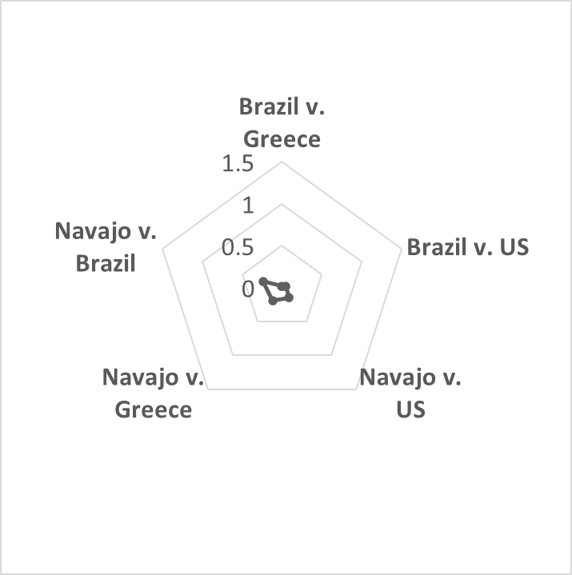
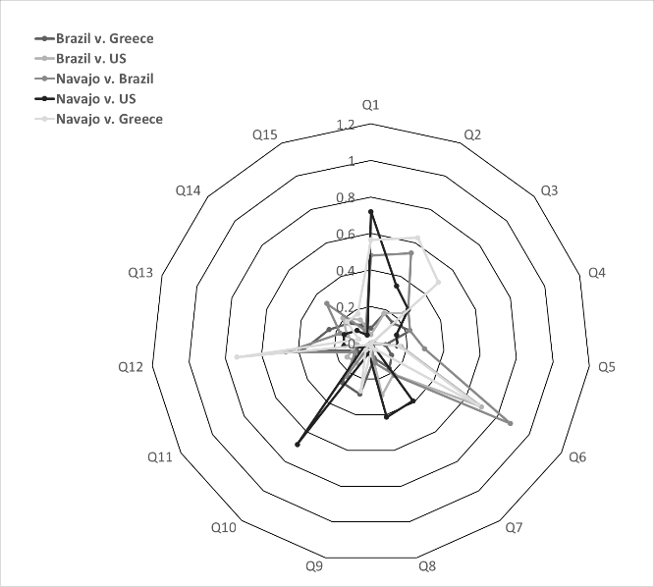
Understanding Environmental Worldviews (EW)
Most Similar Environmental Worldviews using Radar Graphs Mapping NEP
Cohen’s d Countries Most Similar for all NEP Questions
Strength of Similarity (η2) –
Note Questions 1, 6, 10, 12 most similar

Slide 37
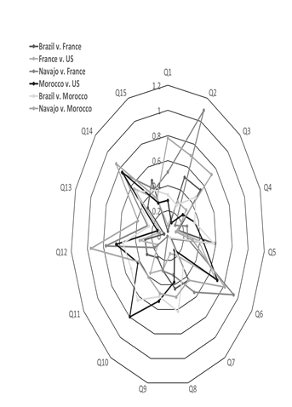
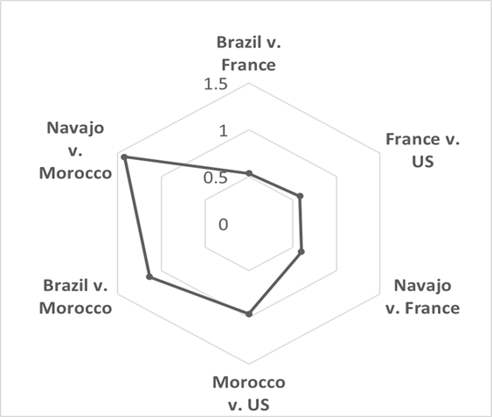
Understanding Environmental Worldviews (EW)
Most Dissimilar Environmental Worldviews using Radar Graphs Mapping NEP
Cohen’s d Countries Most Dissimilar for all NEP Questions
Strength of Difference (η2) –
Note Questions 2, 6, 10, 12, 14 most dissimilar
Notes:
Mention that the strongest similarities were on questions 2, 6, 10, 12, 14.
Question 2 was humans have the right to modify their environment to suit their needs
Question 6 was the Earth has plenty of natural resources if we just learn how to develop them.
Question 10 was ecological crises facing humankind has been greatly exaggerated.
Question 12 was humans were meant to rule over the rest of nature.
Question 14 was humans will eventually learn enough about how nature works to be able to control it.

Slide 38
Findings on Environmental Worldviews (EW)
Culture played a role in understanding the EW of different nations.
NEP score and culture (defined as individualist versus collective) had a statistically significant impact on explaining the differences between countries (F=5.582, sig.=.018, df=887).
Countries that had different cultures had different NEP scores, but culture only moderately explained the difference (Cohen’s d=-.483).
Ideology of the learner (defined as liberal to conservative) played a role in understanding EW
Ideology was a statistically significant factor correlated to environmental worldviews but generally was a weak predictor.
The two questions that stand out from the rest in being considered a strong correlation with ideology were Q5-“humans are severely abusing the environment” (Pearson’s r =.535, sig.=<.001) and Q15- “we will soon experience a major ecological catastrophe” (Pearson’s r=.516, sig=<.001). This was somewhat surprising that the identification of ideology was not more strongly linked to the EW of the learner.

Slide 39
agenda
Introduction
Student Meetings
Tools
Discussion, Questions and Answers
Introduction
Why Global Learning?
Preparing the Learner at home for Global Citizenship
The Importance of Intercultural Training:
Before the Interaction
Two Student Meetings
1. The Ice Breaker
2. The Second Meeting-The New Ecological Paradigm (NEP)
Engaging Tools for Global Learning
Role-Playing Games and Simulations
AR/VR (360-3d) with Project-Based Learning
Conclusions and Questions/Answers

Slide 40
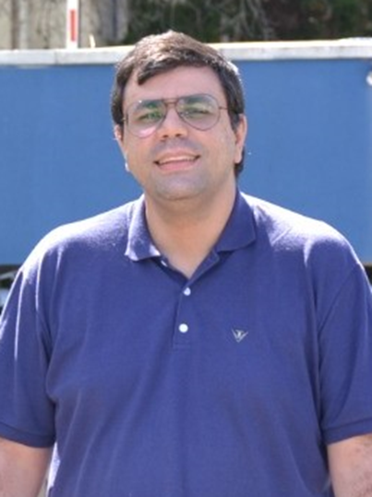
Preparing the Global Citizen for Multidisciplinary Decision-making Using Role-playing Games on Environmental Sustainability in Virtual Exchanges
Dr. Eduardo Verri-Liberado, Sao Paulo State University, Brazil
Dr. Kelly Tzoumis, Professor, School of Public Service, DePaul University, US
Dr. Karima Khalil, Cadi Ayyad University, School of Technology of Essaouira, Morocco
Katie Holloway, DePaul University, US

Slide 41
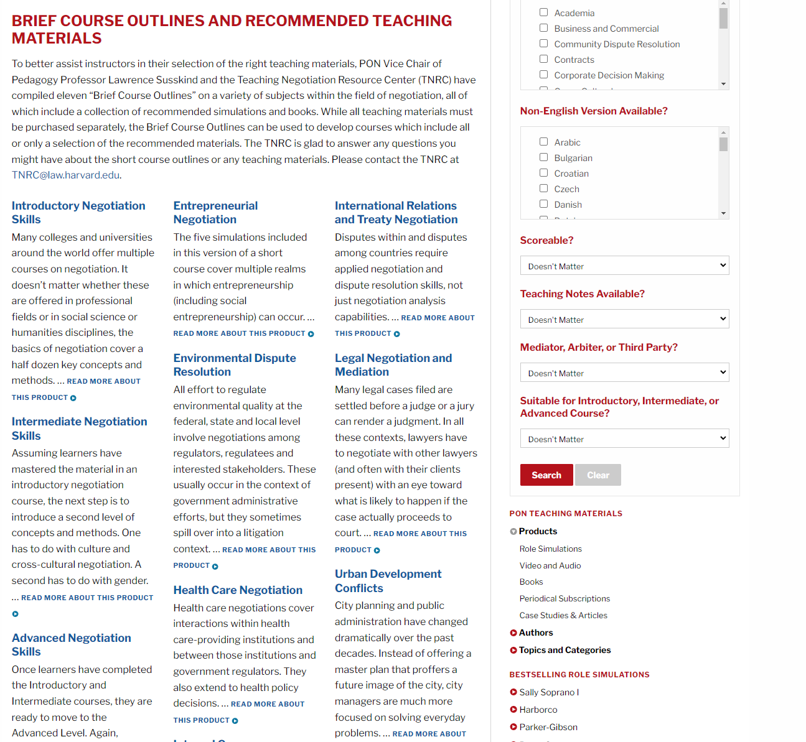
Engaging Tools for Virtual Exchanges
Use synchronous games to simulate the environmental conflicts that engage the use of cultural skills and diplomacy for interaction.
Many games from Harvard PON that are adapted to level of students and time frame.
https://www.pon.harvard.edu/store/
Source: https://www.trainerbubble.com/downloads/negotiate/

Slide 42
Engaging Tools for Virtual Exchanges
Play across time zones with teams of students interacting real-time in the game.
Includes debriefing and post-evaluations from recording the outcomes of the teams. The recordings are posted inside the learning platform.
Students always use different approaches for accomplishing the goal of the game, which leads to different outcomes from each role/team.

Slide 43
Research Design and Methods -- SAMPLE
Fall 2020 to Spring 2023 (6 terms).
322 students playing games.
US students 167.
Non-US students 118.
Interdisciplinary teams with both graduate and undergraduate majors.
34 teams of students.
Most teams led by females (60%) and males (40%).

Slide 44
Example Application of Virtual Exchange Using Role-playing Game Simulations
 | Weekly Participation (begins Week 1) | Global Learning Activity
Week 1 | Intercultural Self-Awareness | Learners take cultural awareness self-assessments. Includes readings on mindfulness and metacognition.
Week 2 | Icebreaker Meeting (30-45 min) | Learners meet in dyads or triads with each country represented based on a schedule that is included with time zones and links for synchronous virtual exchange.
Week 3 | Environmental Worldviews Meeting (45-60 min) | Learners gather in a synchronous virtual exchange meeting to evaluate the results from the New Ecological Paradigm (NEP) survey they took online.
Week 4 | Role-Playing Simulation Games on Sustainability (1.5 h) | Scripts and general instructions are emailed to learners 1-2 weeks before game day.
Week 5 | Analysis and Reflection | Through team recordings, learners analyze and reflect on the outcomes and approaches each team used to gain consensus (or majority agreement).

Slide 45
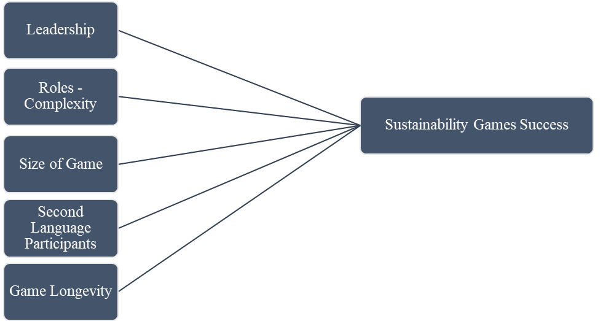
Regression Model Predicting Sustainability Games Success (majority vote on project)
Prepare learners with synchronous game simulations on environmental sustainability to teach:
1. collaborative practical skills,
2. intercultural competencies,
3. reach across disciplines to solve problems.

Slide 46
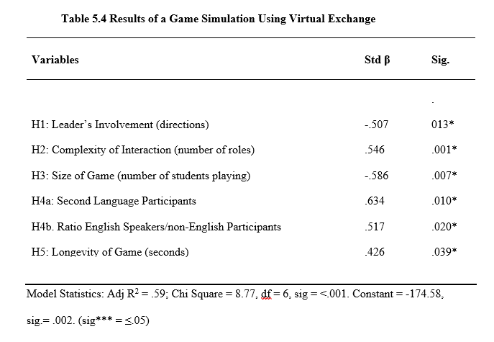
Hypotheses
H1. Less directions by leader, the greater the success.
H2. Greater number of roles, the greater success.
H3. Lower the size of the game, the greater the success.
H4a. Greater the second language participants, the greater the success.
H4b. English speakers assisted inside the game.
H5. A bit longer time allowed for completion of success.

Slide 47
Results: H1 Leader’s Involvement
This means the leader’s style guiding the group is a critical role by providing directions for negotiation but not actively engaging as a participant.
The leader matters for the group in achieving agreement in sustainability projects. However, not as predicted.
The less the time the leader speaks, the greater the agreement that can be achieved.
(std Beta=-.507, sig=.013).
Notes:
Eduardo Slide
You may want to find a better way to consolidate these slides. I left the reporting of results and stats for you here to use. Or you can leave them.

Slide 48
Results: H2 Roles-Complexity
The number of roles does not create a barrier to agreement.
In fact, the greater the number of roles, the more likely the agreement for the passage of the project.
(std beta=.546, sig=.001).
Students were able to build coalitions with a larger team of players.
Notes:
Eduardo Slide

Slide 49
Results: H3 Size of Game
There was a statistical relationship between the lower the number of students playing the game and successful outcomes.
(std beta=-.586, sig=.007).
Games can be more effective with less students playing in the same role.
Notes:
Eduardo Slide

Slide 50
Results: H4a English as a Second Language H4b Ratio of US/Global Students
There was a statistical relationship between the greater the number of English as a second language participants ratio of US/Global students in the game and successful outcome
(std beta=.634, sig=.010).
There was a statistical relationship between the ratio of US/Global students in the game and successful outcome
(std beta=.517, sig=.020).
Games are effective with the greater the number of second language speakers but there has to be a larger ratio of English speakers to non-English speakers.
Notes:
Eduardo Slide

Slide 51
Results: H5 Game Longevity
Students were more likely to reach agreement given more time for the game (std beta=.426, sig=.039).
Notes:
Eduardo Slide

Slide 52
agenda
Introduction
Student Meetings
Tools
Discussion, Questions and Answers
Introduction
Why Global Learning?
Preparing the Learner at home for Global Citizenship
The Importance of Intercultural Training:
Before the Interaction
Two Student Meetings
1. The Ice Breaker
2. The Second Meeting-The New Ecological Paradigm (NEP)
Engaging Tools for Global Learning
Role-Playing Games and Simulations
AR/VR (360-3d) with Project-Based Learning
Conclusions and Questions/Answers

Slide 53
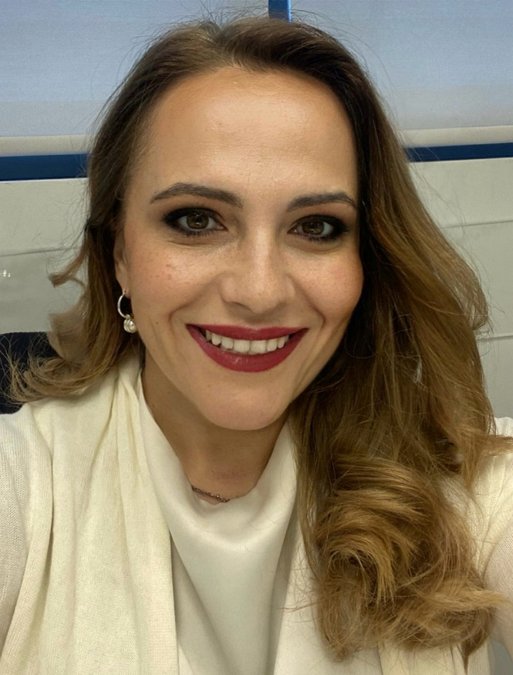
Immersive Virtual Reality as Tool to Promote Sustainable Development Goals
Dr. Elena Douvlou, School of Architecture, Faculty of Engineering & Architecture, Metropolitan College, Greece
edouvlou@mitropolitiko.edu.gr

Slide 54
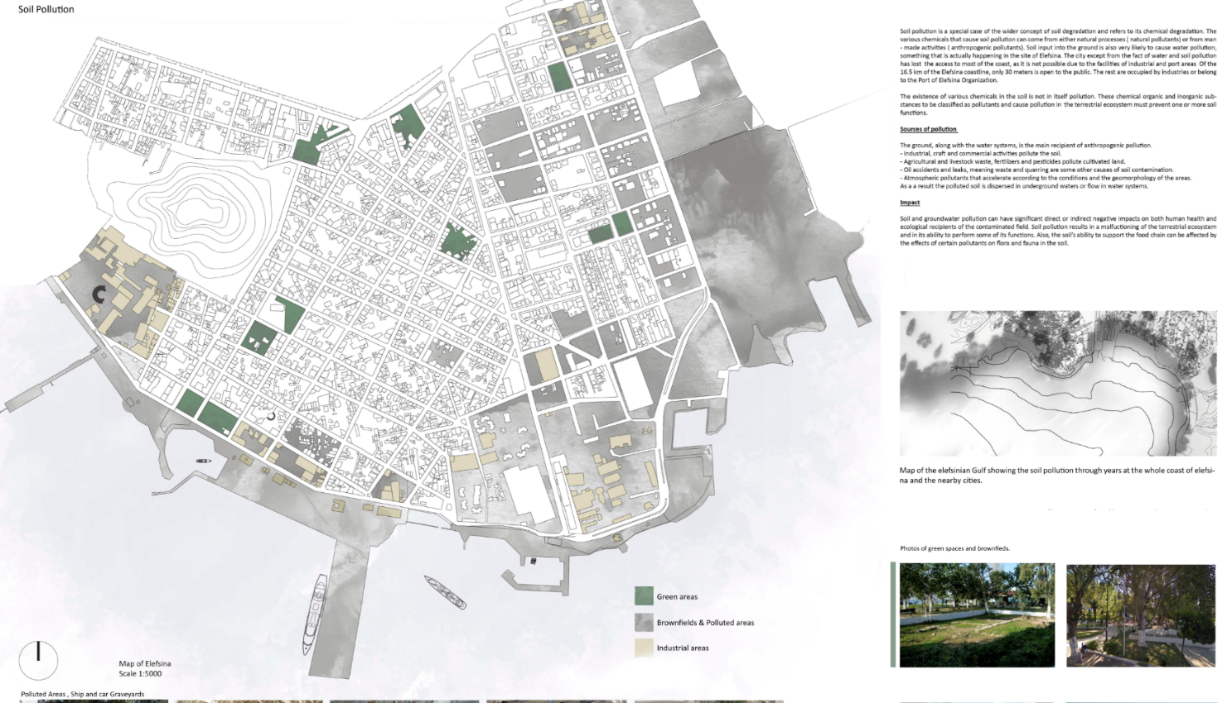
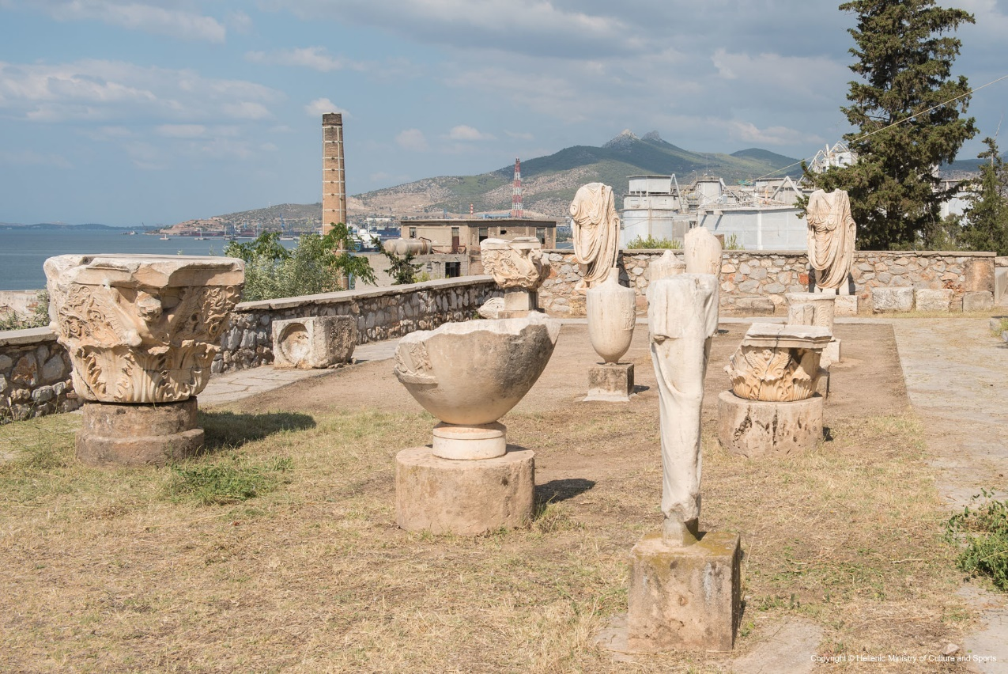
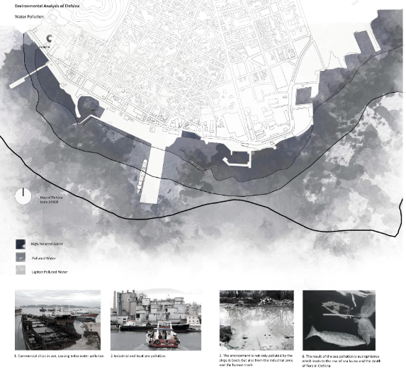
Immersive Virtual Reality as Tool to Promote Sustainable Development Goals

Slide 55
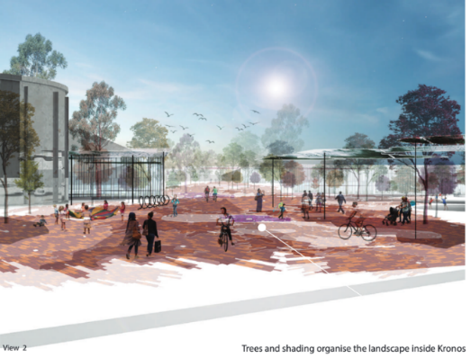
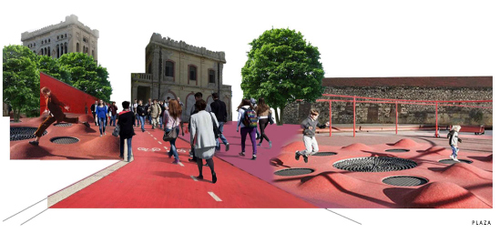
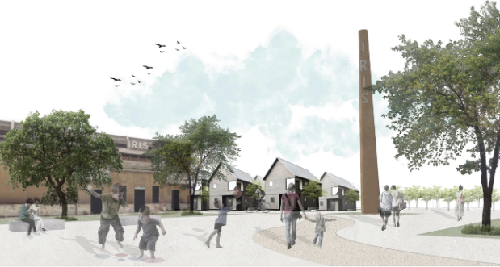
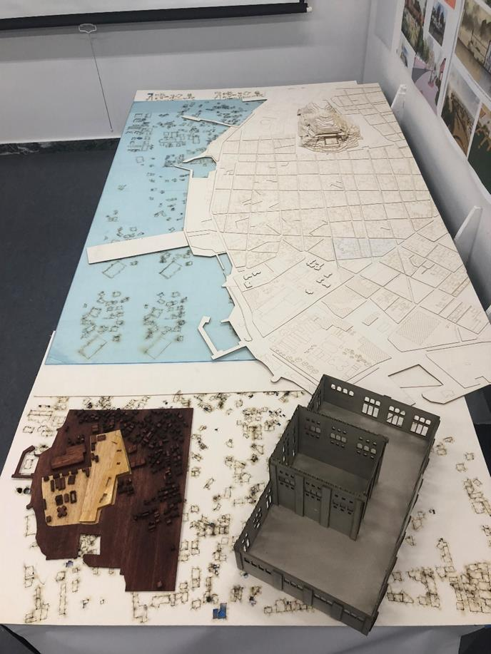
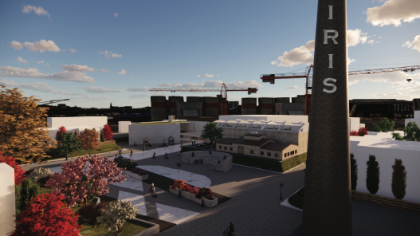
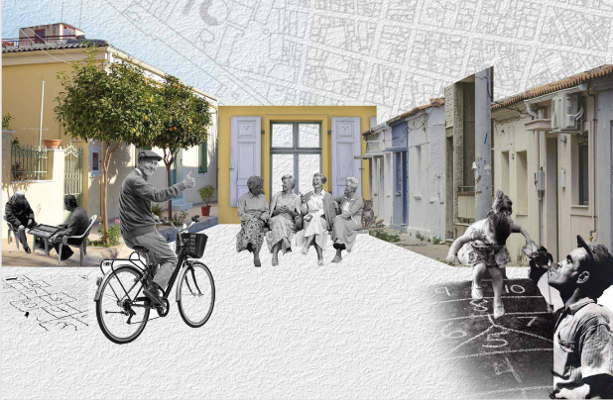
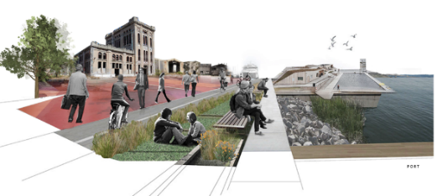
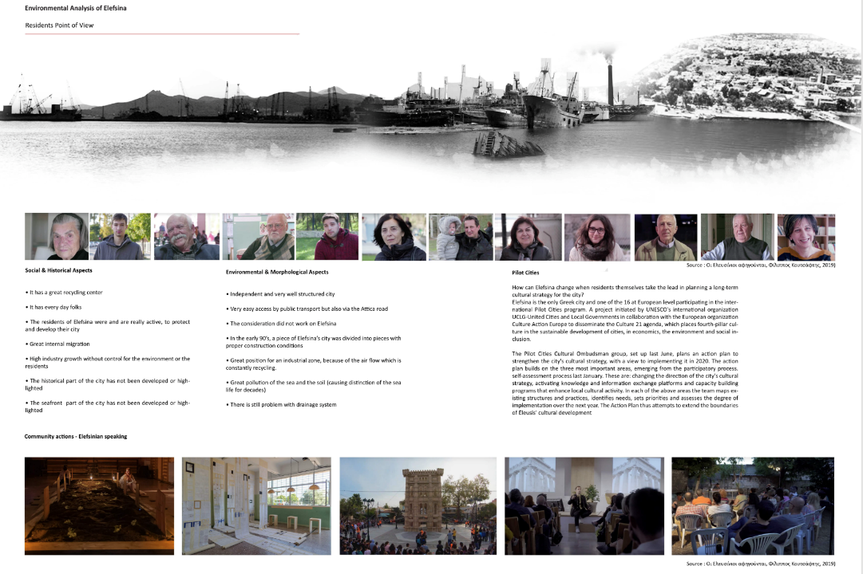
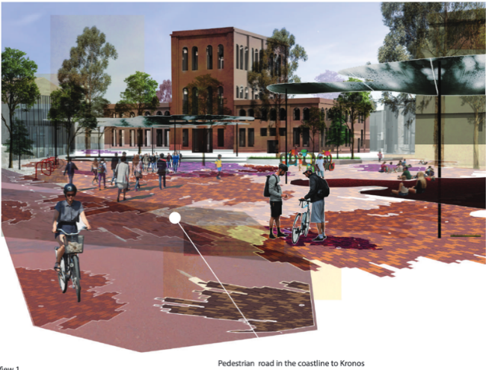
Immersive Virtual Reality as Tool to Promote Sustainable Development Goals

Slide 56
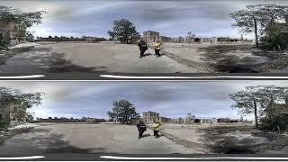
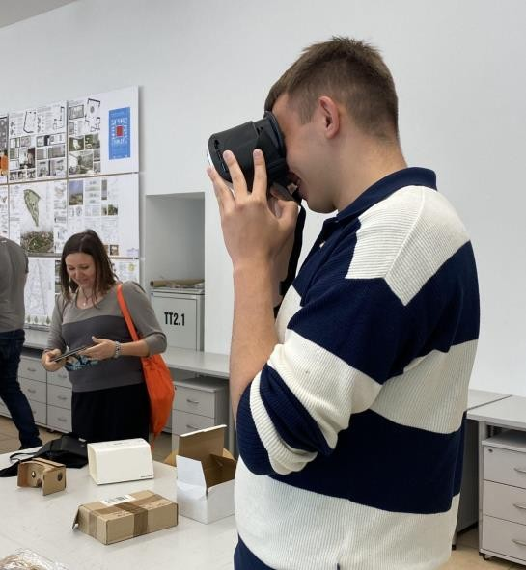
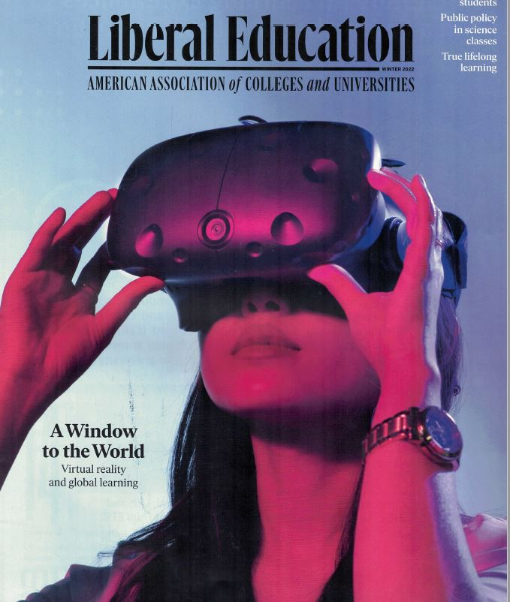
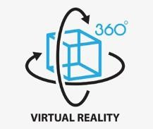
Immersive Virtual Reality as Tool to Promote Sustainable Development Goals
Site visit & interview
https://www.youtube.com/watch?v=n6S6RU-Ycyo

Slide 57
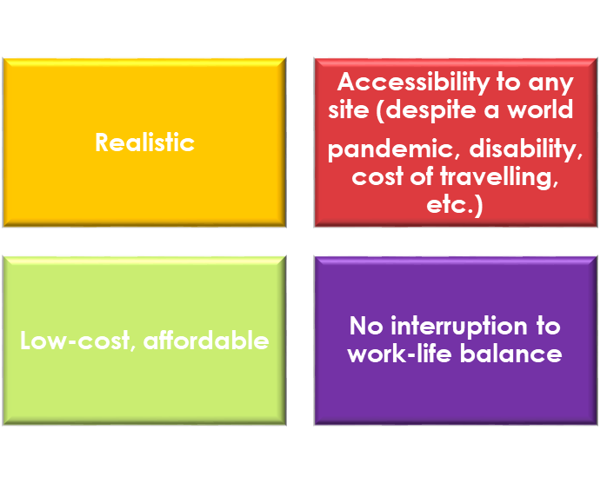
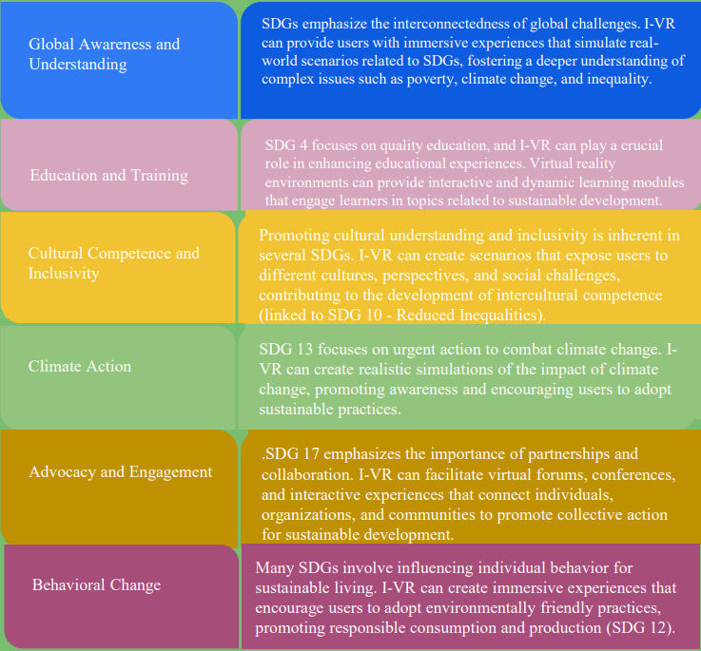
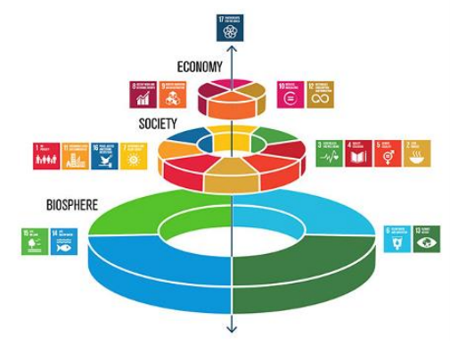
Immersive Virtual Reality as Tool to Promote Sustainable Development Goals

Slide 58
Debates and more
Use debates to have students discuss different sides to an issue.
Takes place synchronously without scripts.
Requires students to research their side of a debate.
Example: Whether to recycle nuclear fuel and waste.
US against
France supports
The importance of praxis of intercultural skills - Human beings learn through a 'hands-on' approach,
John Dewey

Slide 59
Additional Tools for Global Learning using Virtual Exchanges not included in the presentation
Integrating GIS mapping with virtual exchange. Ex. Climate change impacts on coastal rivers and deltas.
Solving local food chain issues working on GVTs doing problem-based learning. Ex. Central America, Mexico, and Asia
Blending field trips with virtual exchanges. Ex. Foreign policy with India and US.
Including community-based service learning projects. Ex. Nigeria and US on oil transitions.
Reading and language programs for women in Afghanistan.
Refugee programs for learning workplace skills. Ex. Jordan and Sudan.
Well-being programs in Venezuela Ex. Youth Violence.

Slide 60
Some Conclusions
Prepare students for workplace and professional praxis.
Most interesting when includes multidisciplinary students to avoid “echo-chamber” of learning.
Most interesting to students when they have a chance to “lead” and connect to different levels of students. Example undergraduates and graduates.
Provides mentoring and social learning for career paths.
Ice Breaker important meeting.

Slide 61
Some Conclusions
6. Intercultural training critical for success. Much research on empathy and meta-cognition for processing over time.
7. This interaction was critical during Covid period for learners.
8. Accessible for students who can not travel for a variety of reasons and affordability.
9. Recent research on well-being is showing that these types of virtual exchange inside curriculum increase the KSA’s and feeling of belonging on projects with global peers to produce an increase sense of well-being.
**A word on digital neo-colonialism and replicating mistakes.

Slide 62
Intercultural and Global Learning – Achieving the UN SDGs Webinar
Prof. Elena Douvlou – Associate Professor, Associate Dean, School of Architecture, Faculty of Engineering & Architecture Metropolitan College, Greece (edouvlou@mitropolitiko.edu.gr)
Prof. Henry Fowler – Associate Professor, Mathematics/Dine Studies, Faculty, Navajo Technical University, Dine Studies, Navajo Technical University, Navajo Nation (hfowler@navajotech.edu)
Prof. Karima Khalil – Professor, Cadi Ayyad University, School of Technology of Essaouira, Morocco (ka.khalil@uca.ma)
Prof. Eduardo Verri Liberado, – Assistant Professor, Sao Paulo State University (UNESP), Institute of Science and Technology, Sorocaba, Brazil (verri.liberado@unesp.br)
Prof. Kelly Tzoumis – Professor, DePaul University, School of Public Service, Chicago, IL USA (KTzoumis@DePaul.edu)

